Slide 1
TEAM 14
Cherie Blair Foundation Marketplace

Slide 2
The Team
Stefano Sesia
Yasen Lilov
Kristiyan Dimitrov
Laura Bogatu
Andrew McClusky
Yordan Yordanov

Slide 3
The Marketplace
Features
Personal space for mentees,mentors and customers
Database with encrypted data
Search engine algorithm

Slide 4
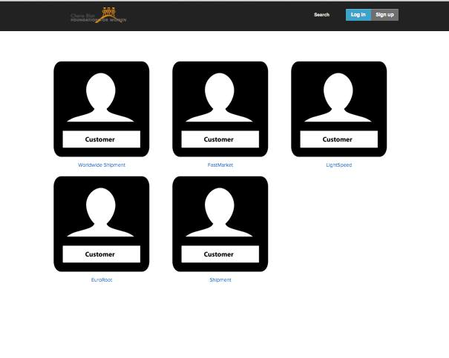
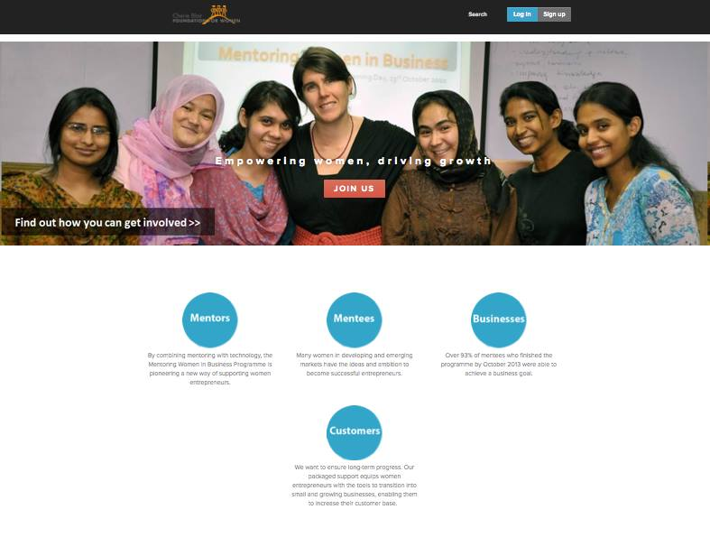
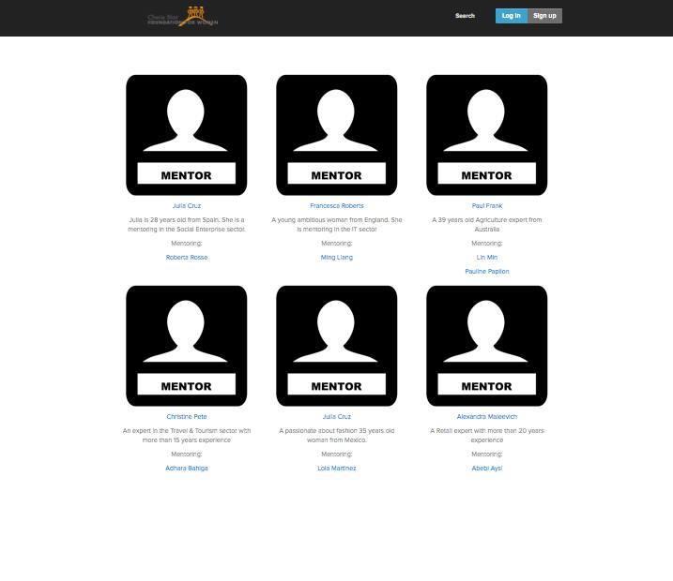
The website

Slide 5
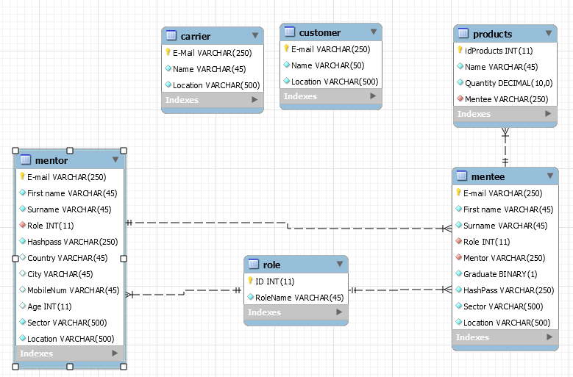
The Database
Information about mentees, mentors, customers and carriers
Information encrypted with SHA2
Information about location

Slide 6
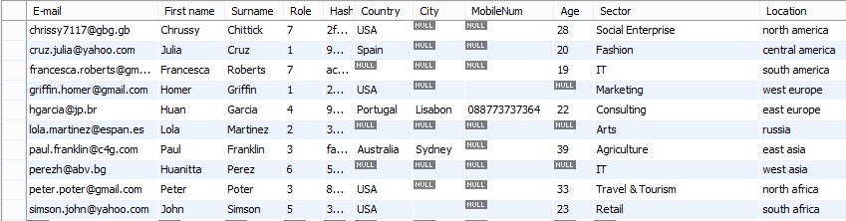
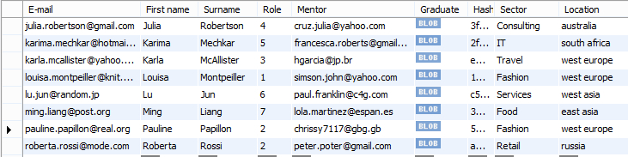
The data
Updated and verified by Cherie Blair Foundation (as specifically asked)
Made up for demonstrational purposes
Automated conversion between different scales

Slide 7
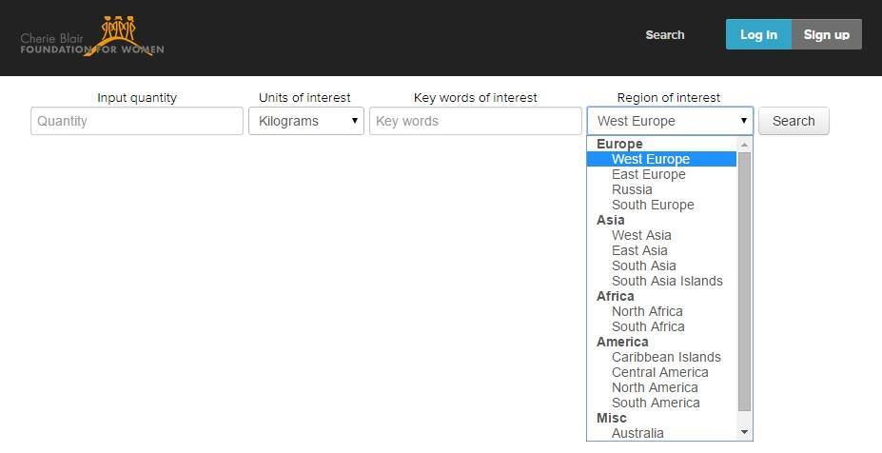
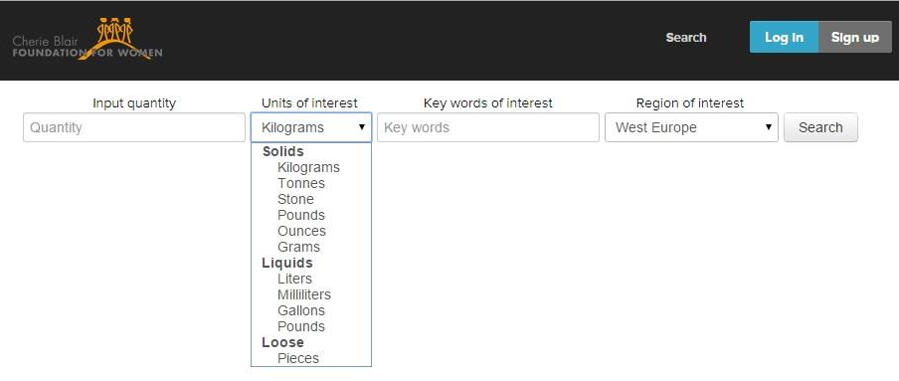
The search engine

Slide 8
Future features
Different access of data displayed on pages according to different user types.
‘Saved Search’ feature
Notifies interested customers when new products/services are available
Notes:
More secure for little mentee
If the exact product is not available, producers of similar products are notified

Slide 9
Benefits (for the customers)
A platform to find available products/services
A smart search engine to display the best match for their needs

Slide 10
Benefits (for the mantees)
Matching efficiently their products/services to potential buyers
A platform to advertise products or services

Slide 11
Thanks for your attention!
Do you have any questions?

